Slide 1
Induction 2024-2025
“Our vision is for all partners to work together effectively to enable and empower people in South Tyneside to be free and safe from abuse and neglect”

Slide 2
Hello and welcome to the South Tyneside Safeguarding Adults Board (STSAB)
I am delighted to welcome you to the South Tyneside Safeguarding Adults Board (STSAB) and thank you for taking on this very important role.
This induction pack has been developed to provide new STSAB members with an introduction to functions of the STSAB and their roles and responsibilities.
Your role as an STSAB member is crucial to the STSAB being able to meet its duties and responsibilities. It is important that you feel able to actively contribute to all meetings and to be able to promote the aims of the STSAB.

Slide 3
The Care Act 2014
The Care Act 2014 requires Local Authorities to establish Local Safeguarding Adults Boards (SABs) involving key local partners as listed in section 43 of the Act. It also requires these board partners to cooperate with each other in the establishment and operation of this partnership board. This document details the arrangements for the board partners within South Tyneside to carry out their functions as laid out in legislation and guidance.

Slide 4
The Aim of the SAB
Ensure that local safeguarding arrangements are in place as defined by the Care Act 2014 and relevant statutory guidance
Leading adult safeguarding arrangements across its locality, overseeing and coordinating the effectiveness of the safeguarding work of its member and partner agencies
Working collaboratively to prevent abuse and neglect where possible
Ensuring that agencies and individuals give timely and proportionate responses when abuse or neglect have occurred
Ensuring that safeguarding practice is continuously improving and enhancing the quality of life of adults in its area
Ensuring that safeguarding practice is person-centred and outcome-focussed

Slide 5
Making Safeguarding Personal and The 6 Key Principles of the Care Act
Making Safeguarding Personal (MSP): MSP means that the safeguarding process should be person-led and outcome-focussed, enhancing the individual’s involvement and choice and control together with seeking to improve quality of life, wellbeing and safety. The 6 key principles below underpin all adult safeguarding work:
Empowerment: people being supported and encouraged to make their own decisions and give informed consent
Prevention: it is better to take action before harm occurs
Proportionality: the intrusive response appropriate to the risk presented
Protection: support and representation for those in greatest need
Partnership: local solutions through services working with their communities – communities have a part to play in preventing, detecting and reporting neglect and abuse
Accountability: accountability and transparency in safeguarding practice

Slide 6
Types of Abuse
Physical Abuse
Domestic Violence or Abuse
Sexual Abuse
Psychological or Emotional Abuse
Financial or Material Abuse
Modern Slavery
Discriminatory Abuse
Organisational or Institutional Abuse
Neglect or Acts of Omission
Self-Neglect
Click the link for Types and Indicators of Abuse and Neglect

Slide 7
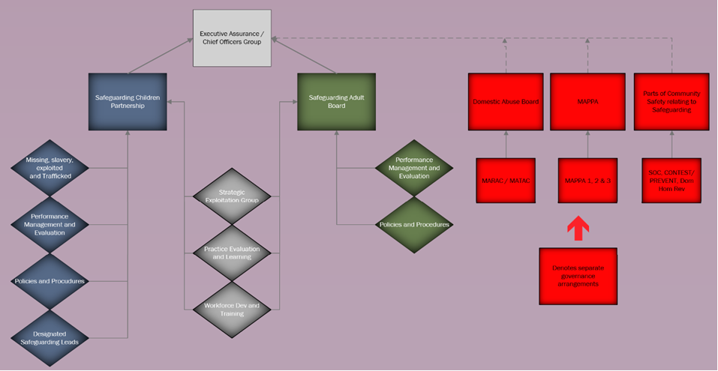
The Structure of the SAB

Slide 8
Roles and Responsibilities
It is the responsibility of the STSAB to:
Produce an Annual Report
Publish its Strategic Plan
Undertake Safeguarding Adult Reviews (SARs) where the criteria is met and to ensure learning from reviews are understood and acted upon
Audit and evaluate how well services work together to protect adults at risk
Put in place appropriate objectives and performance indicators
Encourage and develop effective working relationships between different services
Ensure there is a level of understanding and agreement across agencies regarding operational definitions and thresholds for intervention
Improve local ways of working through national and local experience and research
Seek to ensure that the voice of adults is influential in the priority setting and evaluation of the impact the work of the Board has. This will include drawing on SAB members evaluations from their engagement/survey methods and incorporating co-production

Slide 9
Roles and Responsibilities
It is also the responsibility of the STSAB to audit the effectiveness of arrangements made by SAB partners within their own agency to safeguarding adults on the following:
Senior Management commitment to safeguarding adults
A clear statement of the agencies' responsibilities towards safeguarding adults is made available to all staff
Clear lines of accountability for work on safeguarding and promoting the welfare of adults at risk
Service development takes account of the need to safeguard and promote the wellbeing of adults at risk
Provision of multi-agency safeguarding training for all staff
Safe recruitment
Effective inter-agency working to safeguard and promote the wellbeing of adults at risk
Information sharing
Monitoring and inspection of safeguarding arrangements
Communicating shared responsibilities
Ensuring safeguarding training is delivered
Raising awareness of safeguarding within the wider community

Slide 10
Governance Arrangements
The responsibility for safeguarding sits with the three statutory partners. They are:
South Tyneside Council
NHS North East and North Cumbria Integrated Care Board
Northumbria Police
The STSAB members are accountable to the STSAB via their accountability to the agencies they represent
Each constituent agency should contribute to the development and ownership of the Strategic Plan, Business Plan and Safeguarding Policies and Procedures
An Annual Report will be submitted to the Chief Executive, Leader of the Council, the Police and Crime Commissioner, the local Healthwatch and the Chair of the Health and Wellbeing Board
The STSAB will report bi-annually to the Safeguarding Panel and the People’s Select Committee of South Tyneside Council where elected members can provide both scrutiny and challenge around the effectiveness of the STSAB’s activities

Slide 11
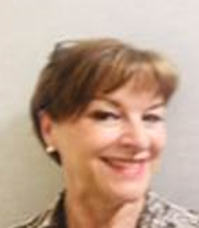
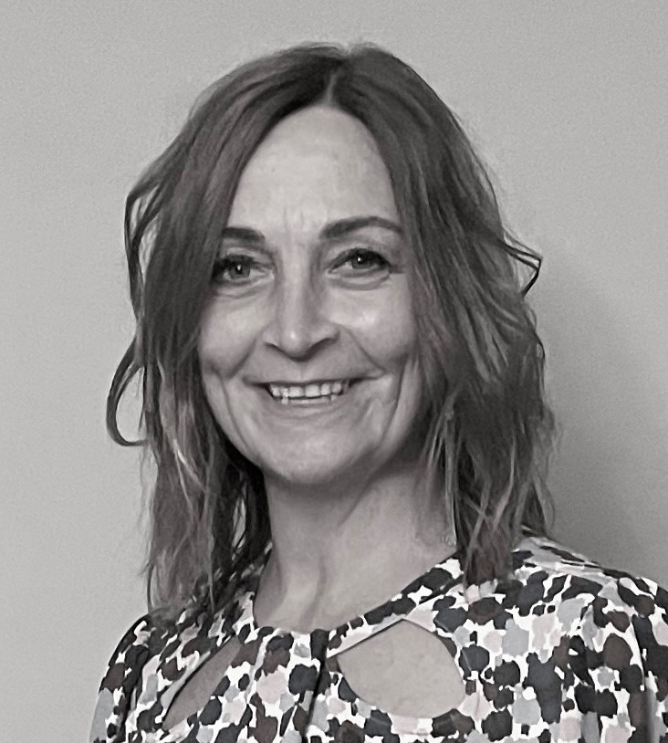
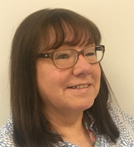
Meet the STSAB Business Unit
Jackie Nolan – Business Manager for the Partnership
Role to ensure all statutory functions addressed and co-ordinate the work of the Partnership. jacqueline.Nolan@southtyneside.gov.uk
Leah Collinson – Safeguarding Development Officer
Role to support the Business Manager function and develop the day-to-day work of the partnership including engagement with local, regional and national networks.
leah.Collinson@southtyneside.gov.uk
Julie Sloanes – Learning and Development Advisor
Role to develop and deliver the multi-agency safeguarding training programme for both adults and children
Julie.sloanes@southtyneside.gov.uk
Lynn Hodson – Business Support Officer
Role to support the STSCAP Business and the wider Partnership members with all aspect of administration
lynn.Hodson@southtyneside.gov.uk

Slide 12
Useful Contacts
Out of Hours Team (Adults and Children): 0191 456 2093
Care Quality Commission (CQC): 03000 61 61 61
Police: 101 / 999 (if immediate risk of harm to self or others)
Adults - Let’s Talk Team: 0191 424 6000
Children – Multi-Agency Safeguarding Hub (MASH): 0191 424 5010

Slide 13
Worried about someone's safety (safeguarding) - South Tyneside Council
Multi-Agency Policies and Procedures (Children)
Multi-Agency Policies and Procedures (Adults)
Glossary
Additional Information

