Slide 1
Children in Need of Health and Protection
Joint Strategic Needs and Assets Assessment
Charts and Figures
www.southtyneside.gov.uk/jsnaa

Slide 2
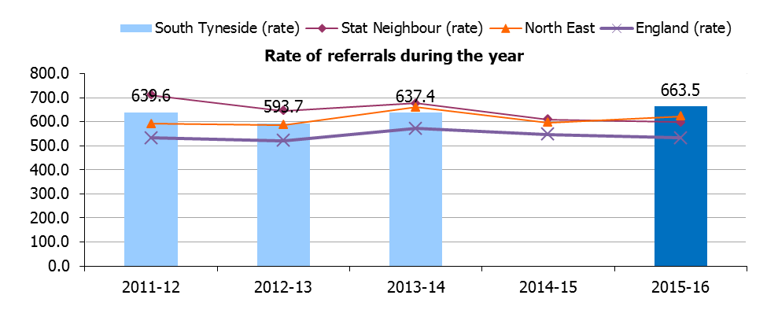
Figure 1 – Rate of referrals during the year

Slide 3
Table 1 – Rate of referrals
 | 2009-10 | 2010-11 | 2011-12 | 2012-13 | 2013-14 | 2014-15 | 2015-16
South Tyneside (number) | 1,377 | 1,220 | 1,893 | 1,745 | 1,871 | 2,797 | 1937
South Tyneside (rate) | 452.0 | 403.1 | 639.6 | 593.7 | 637.4 | N/A | 663.5
Stat Neighbour (rate)* | 665.0 | 667.7 | 711.2 | 645.4 | 676.2 | 609.7 | 598.6
England (rate) | 548.2 | 556.8 | 533.5 | 520.7 | 573.0 | 548.3 | 532.2

Slide 4
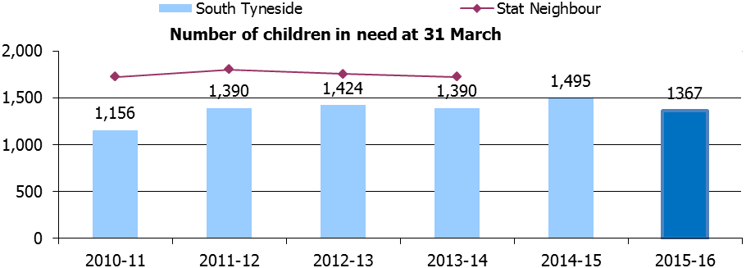
Figure 2 – Number of children in need

Slide 5
Figure 3 – Number of Children in Need vs Child Protection and Looked After Children

Slide 6
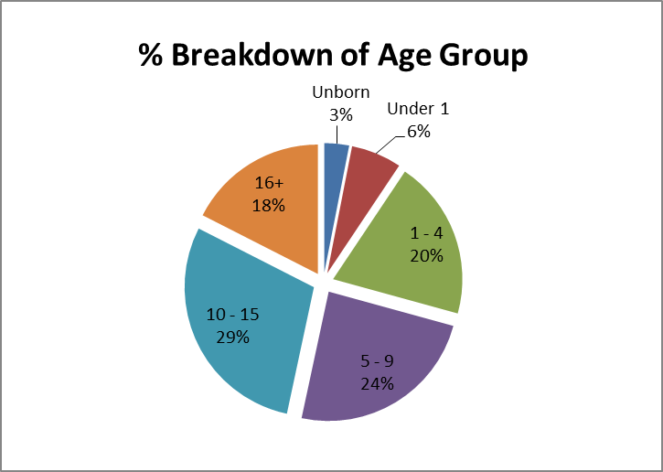
Figure 4 – Children in Need by age
Age | %
Unborn | 3.08%
Under 1 | 6.30%
1 - 4 | 19.89%
5 - 9 | 24.09%
10 - 15 | 29.13%
16+ | 17.51%

Slide 7
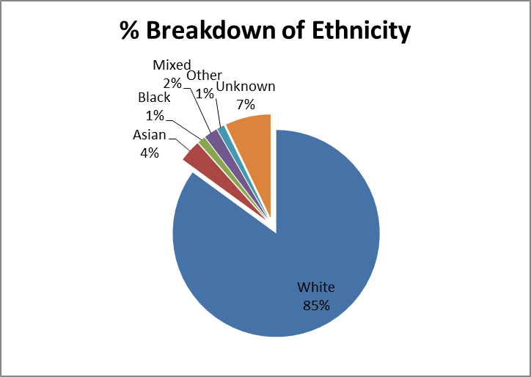
Figure 5 – Children in Need by ethnicity
Ethnicity | %
White | 85.03%
Asian | 3.39%
Black | 1.20%
Mixed | 2.10%
Other | 1.16%
Unknown | 7.12%

Slide 8
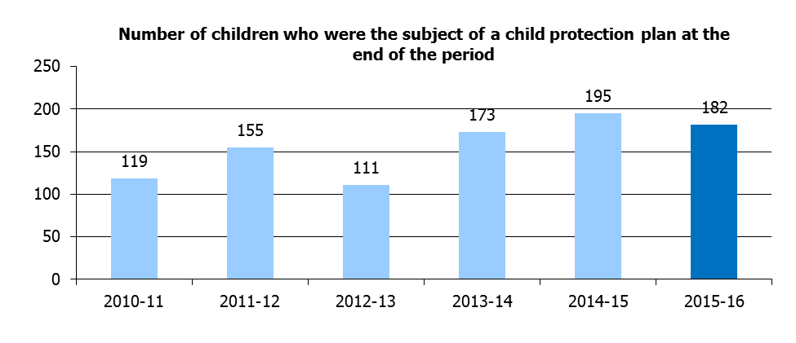
Figure 6 - Child protection plans

Slide 9
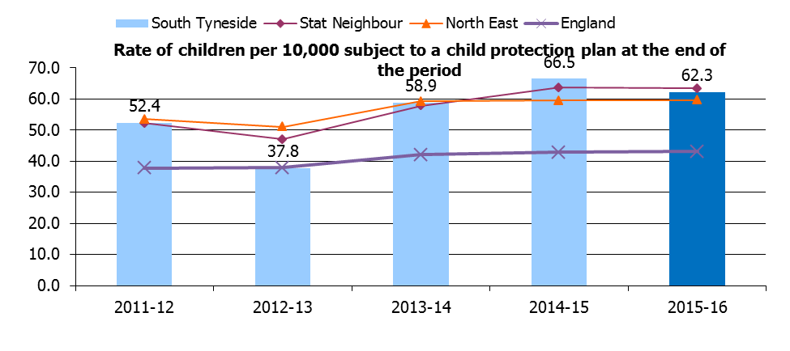
Figure 7 – Rate of children subject to child protection plan

Slide 10
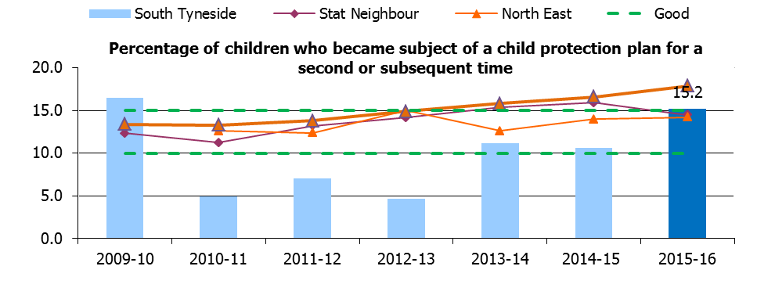
Figure 8 – Repeat child protection plans
 | 2010-11 | 2011-12 | 2012-13 | 2013-14 | 2014-15 | 2015-16
South Tyneside | 4.9 | 7.0 | 4.7 | 11.2 | 10.6 | 15.2
Stat Neighbour | 11.2 | 13.2 | 14.2 | 15.4 | 15.9 | 14.5
North East | 12.6 | 12.4 | 15.0 | 12.6 | 14.0 | 14.2
England | 13.3 | 13.8 | 14.9 | 16 | 17 | 17.9

Slide 11
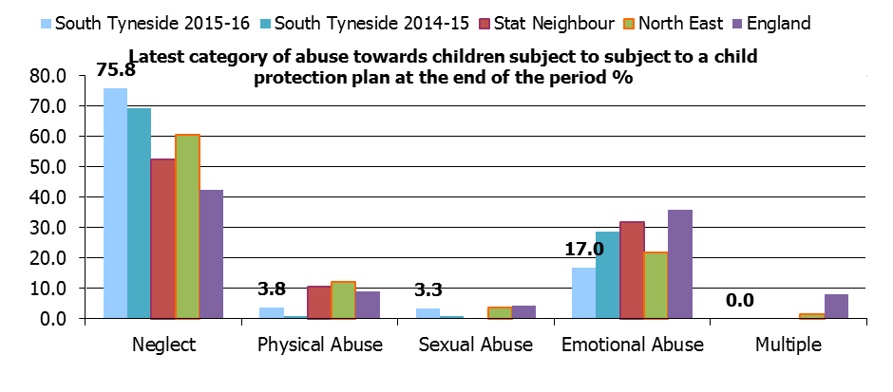
Figure 9 – Abuse towards children
 | Neglect | Physical Abuse | Sexual Abuse | Emotional Abuse | Multiple
South Tyneside 2015-16 | 75.8 | 3.8 | 3.3 | 17.0 | 0.0
South Tyneside 2014-15 | 69.5 | 0.8 | 0.8 | 28.8 | 0.0
Stat Neighbour | 52.4 | 10.5 | n/a | 31.8 | n/a
North East | 60.5 | 12.1 | 3.7 | 22.0 | 1.7
England | 42.6 | 9.0 | 4.4 | 35.9 | 8.1

